Slide 1
INTEREST RATE
The cost of money;
Interest rate levels;
Determination of market interest rates;
Term structure of interest rate;
Shape of yield curve;
Using yield curve to estimate future interest rate;
Macro economic factors influencing interest rate;
Interest rate and business decision

Slide 2
The Cost of Money
Price paid for using the money (Debt for loan and Dividend for equity)
Cost varies from economy to economy and from time to time within same economy
Mainly affected by supply of and demand for investment capital. Other fundamental factors include
Production Opportunities
Time Preference for Consumption
Risk
Inflation

Slide 3
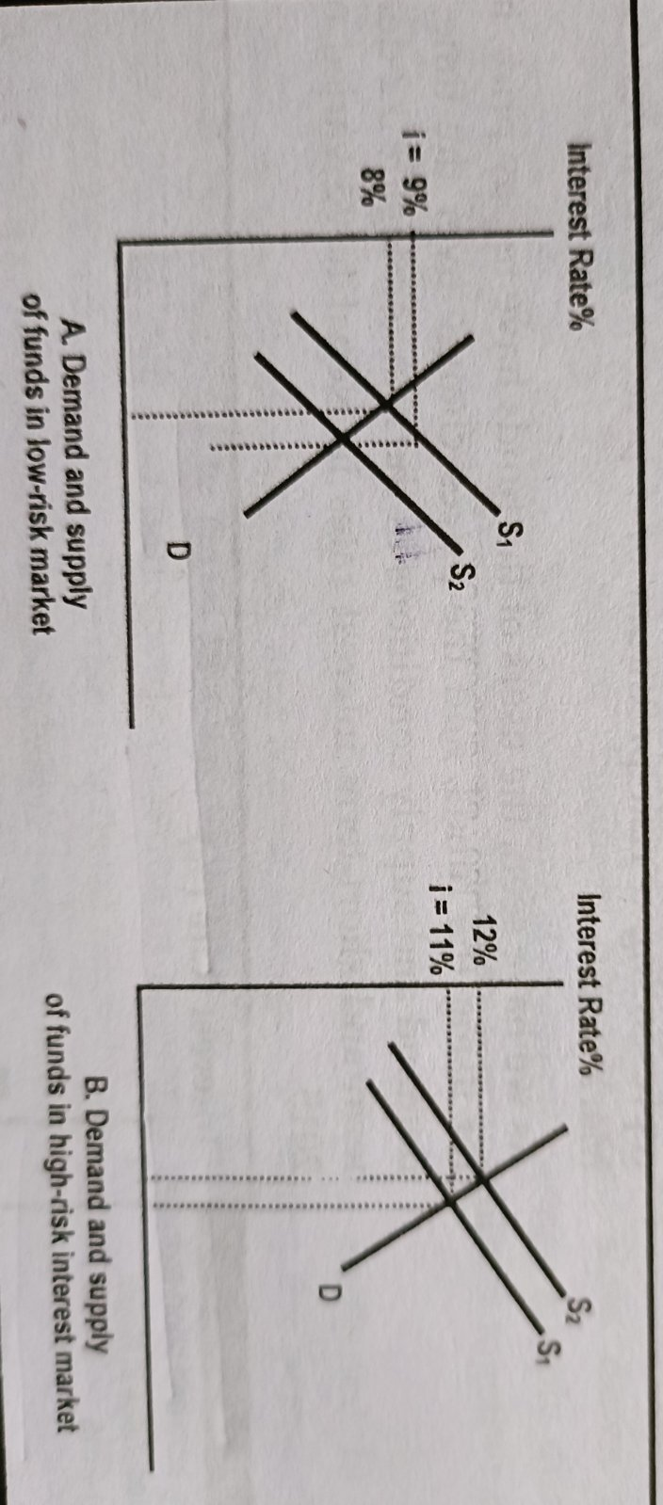
Interest Rate Levels
Interest is cost for user of funds and revenue for supplier of funds
Capital market are not independent as demand for and supply of funds in market A also affects the demand and supply of funds in Market B resulting new equilibrium

Slide 4
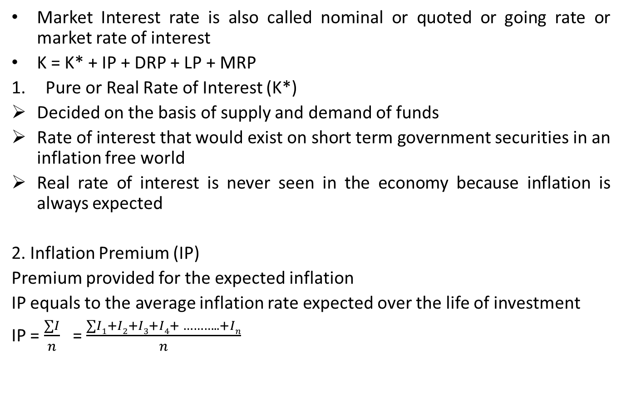
Determinants of Market Interest Rate
Market Interest rate is also called nominal or quoted or going rate or market rate of interest
K = K* + IP + DRP + LP + MRP
Pure or Real Rate of Interest (K*)
Decided on the basis of supply and demand of funds
Rate of interest that would exist on short term government securities in an inflation free world
Real rate of interest is never seen in the economy because inflation is always expected
2. Inflation Premium (IP)
Premium provided for the expected inflation
IP equals to the average inflation rate expected over the life of investment
IP = $\frac{∑I}{n}$ = $\frac{∑I1+I2+I3+I4+ ……….. +In}{n}$

Slide 5
Determinants of Market Interest Rate
3. Default Risk Premium (DRP)
Additional payment above risk free rate
Difference between the interest rate on a treasury bond and a corporate bond of equal maturity and marketability.
Treasury Securities have no default risk
4. Liquidity Premium (LP)
Liquidity = marketability or convertibility of securities into cash
If security is not liquid, investors will add liquidity premium when they determine the interest rate of such securities
Market interest rate will be higher for securities with lower liquidity
5. Maturity Risk Premium (MRP)
Change in interest rate results change in value of securities
Longer the time to maturity, mire significant will be effect of a movement in interest rate
MRP will be more if security has longer life than the security having shorter life

Slide 6
Determinants of Market Interest Rate
Nominal or Quoted Risk free rate of Interest (K_{RF})
Nominal Risk free rate of interest (K_{RF}) = Real risk free rate (K*) + IP
Example Problem:
Suppose it is now 1st Baisakh, 2079. Assume that at the beginning of this year, the expected rate of inflation was 10%. For 2080, it is expected 8%; 6% for 2081 and 4% thereafter.
Required
Average expected inflation rate over the 5 year period 2069-2073 (use arithmetic average)
What average nominal interest rate would, over the 5 –years period produce 2% real rate of return
Assume a pure rate of 2% and a maturity premium which starts at 0.2 percent and increases by 0.2 percent each year, estimate the interest rate in 1st Baisakh, 2079 on bonds that mature in 1,2,5,10 and 20 years.

Slide 7
Term Structure of Interest Rate and Yield Curve
The relationship between the yield on securities and the securities maturities
Sometimes (rate on STF < rate on LTF) other times (rate on STD > LTF)
Describe the relationship between long and short term interest rate
Borrowers and lenders should understand:
How long and short term rates relate to each other?
What causes shifts in their relative levels?
Term to Maturity | Interest Rates
 | March, 1980 | January, 1995
6 months | 15.0% | 6.4%
1 year | 14.0% | 7.0%
5 years | 13.5% | 7.7%
10 years | 12.8% | 7.9%
20 years | 12.5% | 8.0%

Slide 8
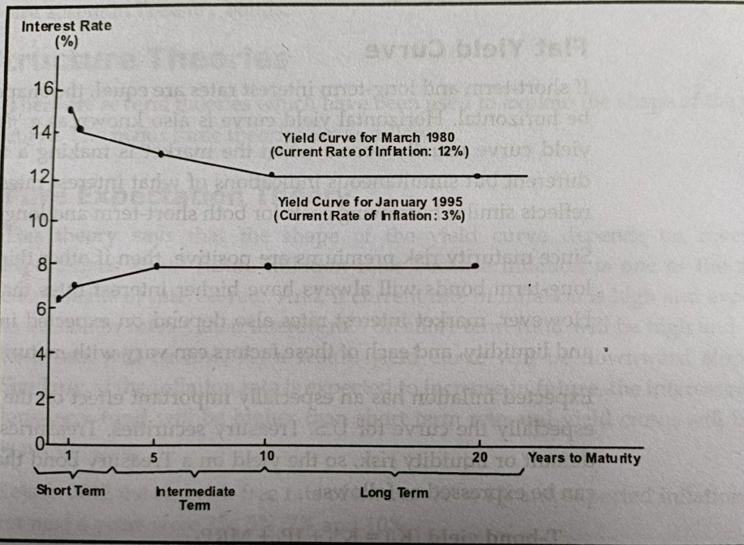
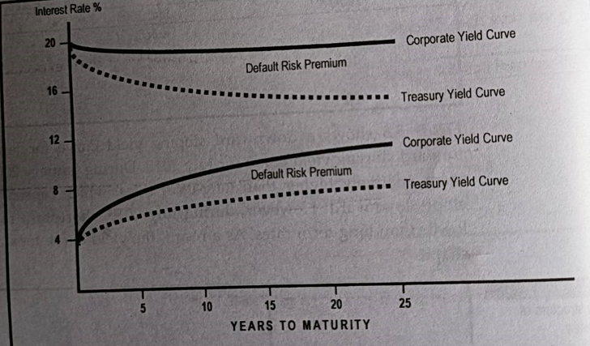
Yield Curve
A curve that shows relation between short term and long term interest rate is called yield curve
March 1980, downward sloping ; January 1995, upward sloping.
Would take humped shape if both short and long term rate were lower than medium term rates

Slide 9
Shape of Yield Curve
Yield curve is a graphic presentation showing the relationship between yields and maturities of securities
Shape of yield curve is not static as it changes overtime as per change on expected inflation rates, supply and demand conditions as well as change in interest rate
Upward Slopping Yield Curve
Downward Slopping Yield Curve
Flat Yield Curve
₀k_{n} (T-Bond) = k* + IP_{n} + MRP_{n}
₀k_{n} (Corporate-Bond) = k* + IP_{n} + MRP_{n}+ DRP_{n} + LP_{n}
Additional default risk and liquidity risk associated with long term corporate securities, the long term corporate yield is higher
Example Problem:
Assume that the real risk free rate is 3.2 percent. Inflation is expected to average 4 percent a year for the next 6 years, after which time inflation is expected to average 5 percent a year. A 10 year corporate bond has a yield of 12 percent, which includes a liquidity premium of 0.50 percent and maturity risk premium of 2 percent. What is default risk premium?

Slide 10
Term Structure Theories
Pure Expectation Theory
Shape of yield curve depends on investor’s expectations about future inflation rates.
If current inflation is high and expected to decline in future, then interest on short term fund will be high and long term rate will be low. As a result yield curve will be downward slopping
2. Liquidity Preference Theory
Explains that short term bonds yield will be less than long term for two reasons:
Borrowers choose long term debt
Investors prefer short term investment
3. Market Segmentation Theory
Each lender and each borrower has a preferred maturity
Market for short term securities is segmented from the long term market and vice versa
Slope of yield curve depends on the supply of and demands for funds in long term market relatively to the short term market

Slide 11
Using Yield Curve to Estimate Future Interest Rate
Pure expectation theory provides a clear cut guideline to estimate the future interest rates and inflations.
Estimation of future interest rate by using yield curve is based on following assumption:
Determination of future interest rates focus only on the Treasury securities
All treasury securities are assumed to fall in similar risk class as such they have no maturity risk.
In the absence of maturity risk premium, long term interest rates are simply the weighted average of current and future short term rates
1 year T-bill =5% ad 2 year T-bill = 6%. If you want to invest for two years we have two options:
Buy two year bonds today
Buy one year bond today; hold it for one year and then reinvest for next year the proceed realized at the end of year one.
(1+ ₀k_{n}) = [(1+ ₀k₁) (1+ ₁k₂) (1+ ₂k₃)….. (1+ _{n-1}k_{n})]^{1/n}

Slide 12
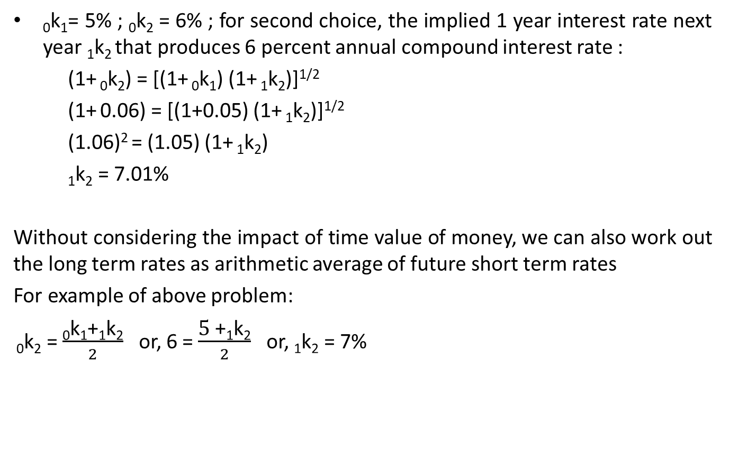
Previous Problem
₀k₁= 5% ; ₀k₂ = 6% ; for second choice, the implied 1 year interest rate next year ₁k₂ that produces 6 percent annual compound interest rate :
(1+ ₀k₂) = [(1+ ₀k₁) (1+ ₁k₂)]^{1/2}
(1+ 0.06) = [(1+0.05) (1+ ₁k₂)]^{1/2}
(1.06)² = (1.05) (1+ ₁k₂)
₁k₂ = 7.01%
Without considering the impact of time value of money, we can also work out the long term rates as arithmetic average of future short term rates
For example of above problem:
₀k₂ = $\frac{\text{0}\text{k}\text{1}\text{+}\text{1}\text{k}\text{2}}{2}$ or, 6 = $\frac{\text{5 }\text{+}\text{1}\text{k}\text{2}}{2}$ or, $\text{1}\text{k}\text{2}$ = 7%

Slide 13
Macro Economic Factors Influencing Interest Rate
Government Policy
Budget Deficit
International Factors
Business Activity
Inflationary Expectations
Interest Rates and Business Decision
In setting sound Financing Policy
Using entirely short term funds or long term funds to finance firm’s assets might be very risky when interest rate fluctuate adversely.
Amount of long term and short term debt to be used to finance firm’s assets, to a larger extent, depends on the nature of assets.

